Slide 1
Database System Development Lifecycle (DBSDLC)
SECD2523 Database
Semester 2 2020/2021

Slide 2
Learning Objective
At the end of the topic, students will be able to:
  Define and describe the stages of the database system development life cycle.
  Define the activities and deliverables in the main phases of database design:
    Conceptual design
    Logical design
    Physical design

Slide 3
Stages of Database Application Lifecycle
Database planning
System definition
Requirements collection
and analysis
DBMS selection
Conceptual database design
Application design
Logical database design
Physical database design
Focus is this course
Database design
Prototyping (optional)
Implementation
Data conversion and loading
Testing
Operational maintenance

Slide 4
1) Database Planning
Management activities that allow stages of database application lifecycle to be realized as efficiently and effectively as possible.
Must be integrated with overall information system (IS) strategy of the organization.

Slide 5
1) Database Planning
Define a clear mission statement
  major aims of database application
  clarify purpose of the database project
  provides clearer path towards the efficient and effective creation of required database application.
  Defined by ones who are driving database project – director or owner of the project
Identify mission objectives
  What tasks that must be supported by the system
  Each objective is one specific task

Slide 6
1) Database Planning
Other information accompanied in mission statement and objectives:
  The work to be done
  The resources with which to do it
  The money to pay for it
Database planning should also include development of standards that govern:
  how data will be collected,
  how the format should be specified,
  what necessary documentation will be needed,
  how design and implementation should proceed.

Slide 7
2) System Definition
Describes scope and boundaries of database application and the major user views.
  System boundaries should involve current and future application areas and users
User view defines what is required of a database application from the perspective of:
  a particular job role (such as Manager or Supervisor) or
  enterprise application area (such as marketing, personnel, or stock control)

Slide 8
2) System Definition
Database application may have one or more user views.
Identifying user views helps ensure that no major users of the database are forgotten when developing requirements for new application.
A user view provides requirements:
  What data to be included in the system
  What transactions to be performed on the data
  Requirements may be distinct or overlap with other views

Slide 9
3) Requirements Collection and Analysis
The process of collecting and analyzing information about the part of organization to be supported by the database application and using this information to identify users’ requirements of new system.
Information is gathered for each major user view including:
  a description of data used or generated;
  details of how data is to be used/generated;
  any additional requirements for new database application.

Slide 10
3) Requirements Collection and Analysis
Information is analyzed to identify requirements to be included in new database application
  Documented in a Requirements specification for new database system
  Presented in a structured/organized using requirement specification techniques, such as SAD techniques, DFD and HIPO charts
Three main approaches in requirements collections and analysis from multiple user views:
  centralized approach;
  view integration approach;
  combination of both approaches.

Slide 11
3) Requirements Collection and Analysis
Centralized approach
  Requirements for each user view are merged into a single set of requirements for the new database system.
  A global data model is created based on the merged requirements (which represents all user views).
  Generally, this approach is preferred when there is a significant overlap in requirements for each user view and the database system is not overly complex.

Slide 12
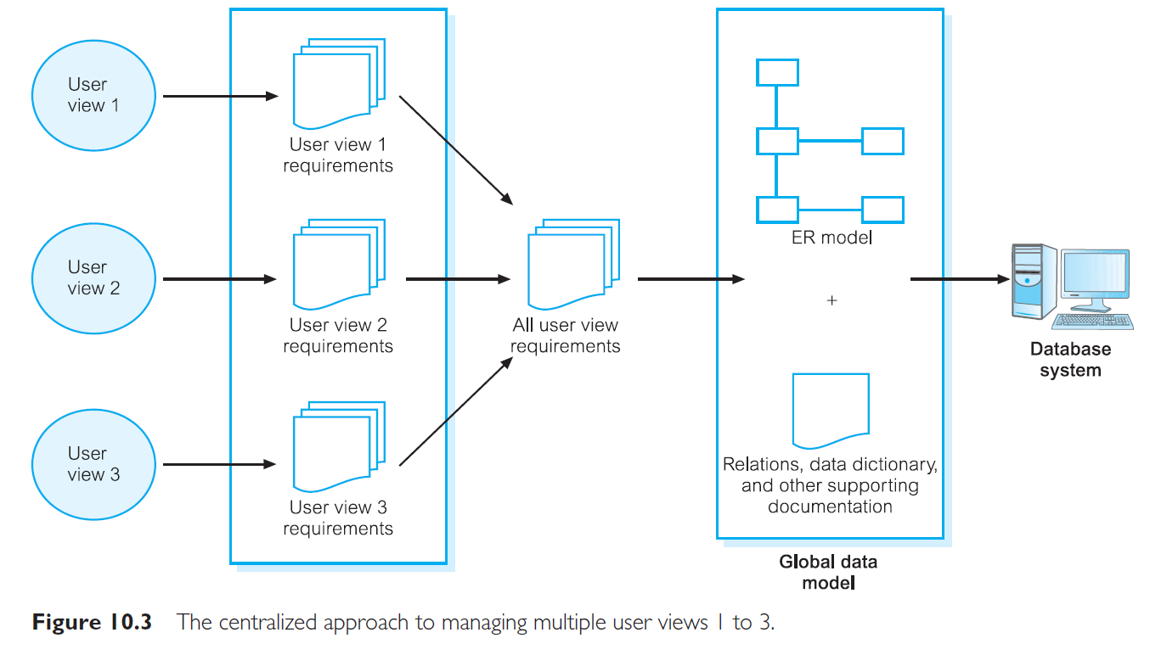
3) Requirements Collection and Analysis
Centralized Approach

Slide 13
3) Requirements Collection and Analysis
View integration approach
  Requirements for each user view are used to build a separate data model.
  Data model representing single user view is called a local data model, composed of diagrams and documentation describing requirements of a particular user view of database.
  Local data models are then merged to produce a global data model, which represents all user views for the database.

Slide 14
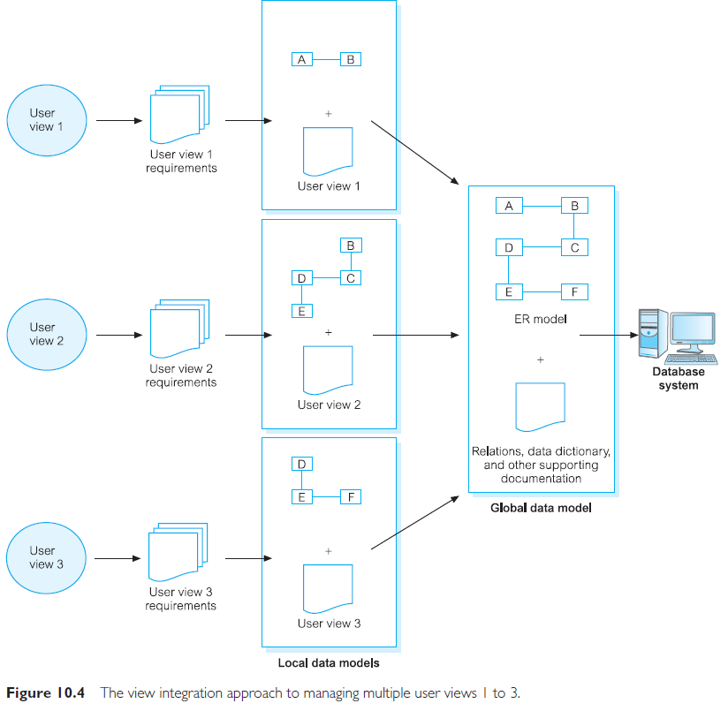
3) Requirements Collection and Analysis
View integration approach

Slide 15
4) Database Design
The process of creating a design for a database that will support the enterprise’s operations and objectives.
Major aims:
  Represent data and relationships between data required by all major application areas and user groups.
  Provide data model that supports any transactions required on the data.
  Specify a minimal design that is appropriately structured to achieve stated performance requirements for the system (such as response times).

Slide 16
4) Database Design
Approaches include:
Top-down
  Starts with developing data models which contain high-level entities and relationships.
  Then refine this high-level data models into a lower-level entities, relationships and attributes.
  Use Entity Relationship Model (ERM)
Bottom-up
  Begins at the fundamental analysis of the associations between attributes
  Grouped into relations that represent types of entities and relationship between entities
  Use Normalization process
Inside-out
  Begins with identifying major entities
  Then spreading out to consider other entities, attributes associated to those first identified.
Mixed
The mixed strategy approach uses both the bottom-up and top-down approach for various parts of the model before finally combining all parts together.

Slide 17
4) Database Design
Main purposes of data modeling include:
  to assist in understanding the meaning (semantics) of the data;
  to facilitate communication about the information requirements.
Building data model requires answering questions about entities, relationships, and attributes.
  A data model ensures we understand:
    each user’s perspective of the data;
    nature of the data itself, independent of its physical representations;
    use of data across user views.

Slide 18
4) Database Design
Three phases of database design:
  Conceptual, Logical and Physical
Conceptual
  Process of constructing a model of information used in an enterprise, independent of all physical considerations.
  Entity Relationship Model; Data dictionary
Logical
  Process of constructing a model of information used in an enterprise based on a specific data model (e.g. relational), but independent of a particular DBMS and other physical considerations.
  Normalized database (relational) schemas
Physical
  Process of producing a description of the implementation of the database on secondary storage; it describes the base relations, file organizations, and indexes design used to achieve efficient access to the data, and any associated integrity constraints and security measures.

Slide 19
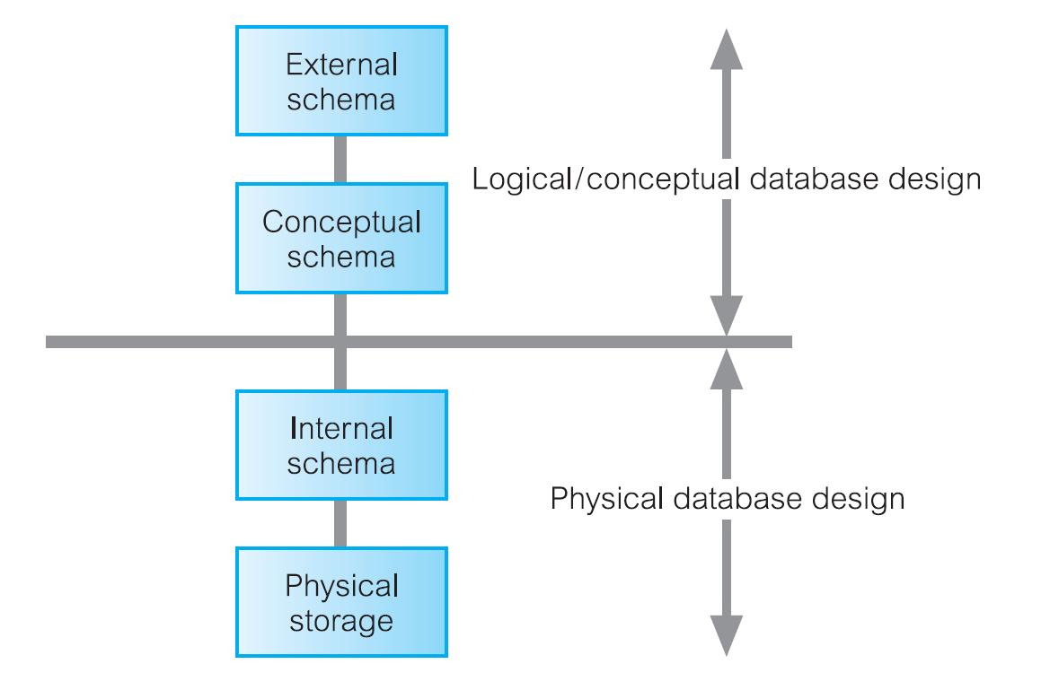
Three-level ANSI-SPARC Architecture and Phases of Database Design

Slide 20
Other Stages
DBMS selection
Application design – User interface (UI) design and application program design
Prototyping
Implementation
Data Conversion and loading
Testing
Operational Maintenance

